Slide 1
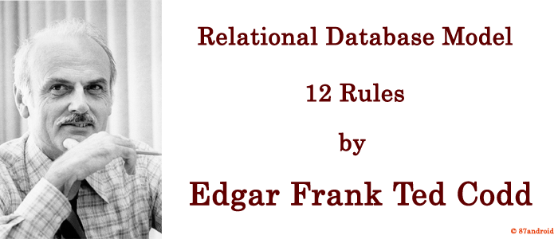
E.F. Codd’s 12 Rules
Rule 0: Foundation rule
Rule 1: Rule of Information
Rule 2: Rule of Guaranteed Access
Rule 3: Rule of Systematic Null Value Support
Rule 4: Rule of Active and online relational Catalog
Rule 5: Rule of Comprehensive Data Sub-language
Rule 6: Rule of Updating Views
Rule 7: Rule of Set level insertion, update and deletion
Rule 8: Rule of Physical Data Independence
Rule 9: Rule of Logical Data Independence
Rule 10: Rule of Integrity Independence
Rule 11: Rule of Distribution Independence
Rule 12: Rule of Non Subversion

